Slide 1

Chapter 1: Introduction

Slide 2
Contents
1. Software modeling
2. Object-oriented methods and the unified modeling language
3. Software architectural design
4. Method and notation
5. Comet: a uml-based software modeling and design method for software applications
6. Uml as a standard
7. Multiple views of software architecture
8. Evolution of software modeling and design methods
9. Evolution of object-oriented analysis and design methods
Why design?

Slide 3

Why design?
Build a pet house

Slide 4


Why design?
High building

Slide 5

Why design?

Slide 6


Why design?

Slide 7
1. SOFTWARE MODELING
Modeling is widely used in science and engineering to provide abstractions of a system at some level of precision and detail
According to the Object Modeling Group (OMG), “modeling is the designing of software applications before coding.”
In model-based software design and development, software modeling is used as an essential part of the software development process.
A better understanding of a system can be obtained by considering it from different perspectives (multiple views): requirements models, static models, and dynamic models of the software system
A graphical modeling language such as UML helps in developing, understanding, and communicating the different views.

Slide 8
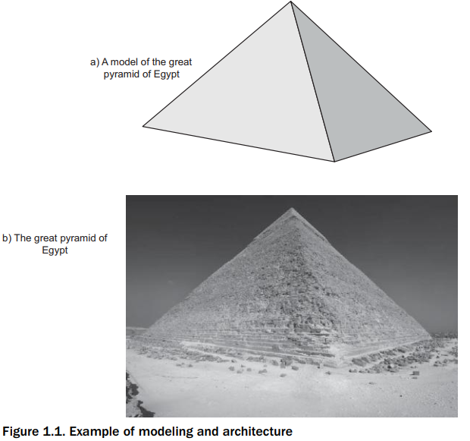
2. OBJECT-ORIENTED METHODS AND THE UNIFIED MODELING LANGUAGE
Object-oriented methods are based on the concepts of information hiding, classes, and inheritance.
the Unified Modeling Language (UML) was developed to provide a standardized graphical language and notation for describing object-oriented models. However, because UML is methodology-independent, it needs to be used together with an object-oriented analysis and design method.

Slide 9
2. OBJECT-ORIENTED METHODS AND THE UNIFIED MODELING LANGUAGE
Modern object-oriented analysis and design methods are model-based and use a combination of use case modeling, static modeling, state machine modeling, and object interaction modeling.
Almost all modern object-oriented methods use the UML notation for describing software requirements, analysis, and design models.
In use case modeling, the functional requirements of the system are defined in terms of use cases and actors.
Static modeling provides a structural view of the system. Classes are defined in terms of their attributes, as well as their relationships with other classes.
Dynamic modeling provides a behavioral view of the system. The use cases are realized to show the interaction among participating objects. Object interaction diagrams are developed to show how objects communicate with each other to realize the use case. The state-dependent aspects of the system are defined with statecharts

Slide 10
3. SOFTWARE ARCHITECTURAL DESIGN
A software architecture (Bass, Clements, and Kazman 2003; Shaw and Garlan 1996) separates the overall structure of the system, in terms of components and their interconnections, from the internal details of the individual components.
A software architecture can be described at different levels of detail. At a high level, it can describe the decomposition of the software system into subsystems. At a lower level, it can describe the decomposition of subsystems into modules or components.
The software quality attributes of a system should be considered when developing the software architecture. These attributes relate to how the architecture addresses important nonfunctional requirements, such as performance, security, and maintainability.

Slide 11
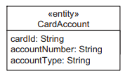
4. METHOD AND NOTATION
A software design notation is a means of describing a software design either graphically or textually or both.
UML is a graphical notation for object-oriented software applications.
class CardAccount
{
cardId: String;
account tNumber: String;
accountType: String
}

Slide 12
4. METHOD AND NOTATION
A software design concept is a fundamental idea that can be applied to designing a system. For example, information hiding is a software design concept.
A software design strategy is an overall plan and direction for developing a design. For example, object-oriented decomposition is a software design strategy.
Software structuring criteria are heuristics or guidelines used to help a designer in structuring a software system into its components. For example, object structuring criteria provide guidelines for decomposing the system into objects.
A software design method is a systematic approach that describes the sequence of steps to follow in order to create a design, given the software requirements of the application
The Collaborative Object Modeling and Design Method, or COMET, uses the UML notation to describe the design. COMET is based on the design concepts of information hiding, classes, inheritance, and concurrent tasks. It uses a design strategy of concurrent object design.
Notes:
Heuristics: sự tìm tòi

Slide 13
5. COMET: A UML-BASED SOFTWARE MODELING AND DESIGN METHOD FOR SOFTWARE APPLICATIONS
This book describes a UML-based software modeling and architectural design method called COMET. COMET is an iterative use case driven and object-oriented software development method that addresses the requirements, analysis, and design modeling phases of the software development life cycle.
In a requirements model, the functional requirements of the system are defined in terms of actors and use cases.
In an analysis model, the use case is realized to describe the objects that participate in the use case and their interactions.
In the design model, the software architecture is developed, addressing issues of distribution, concurrency, and information hiding.

Slide 14
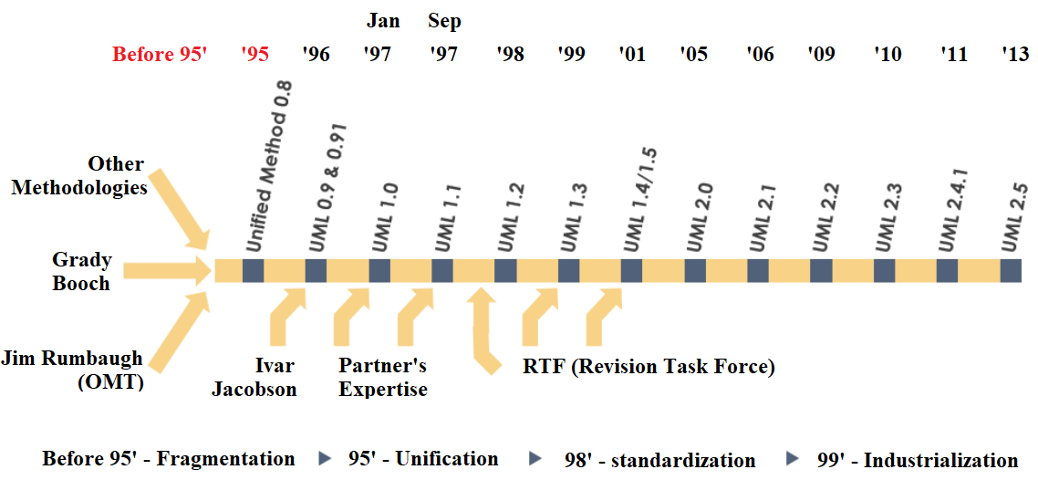
6. UML AS A STANDARD
UML: a standard modeling language and notation for describing object-oriented designs.
The OMG (Object Management Group) maintains UML as a standard. The first adopted version of the standard was UML 1.3. There were minor revisions with UML 1.4 and 1.5. A major revision to the notation was made in 2003 with UML 2.0. The latest books on UML conform to UML 2.0.
Latest version 2.5.1, published Dec/2017

Slide 15
6.1 Model-Driven Architecture with UML
According to the OMG, UML is methodology-independent; UML is a notation for describing the results of an object-oriented analysis and design developed via the methodology of choice.
A UML model can be either a platform-independent model (PIM) or a platform-specific model (PSM). The PIM is a precise model of the software architecture before a commitment is made to a specific platform.
Developing the PIM first is particularly useful because the same PIM can be mapped to different middleware platforms, such as COM, CORBA, .NET, J2EE, Web Services, or another Web platform.
Notes:
Sophisticated brokers: Mối g

Slide 16
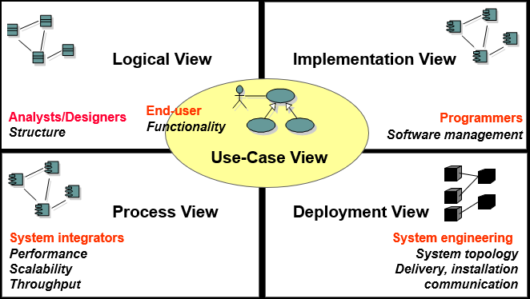
7. MULTIPLE VIEWS OF SOFTWARE ARCHITECTURE
A software architecture can be considered from different perspectives, which are referred to as different views.
Kruchten (Kruchten 1995) introduced the 4+1 view model of software architecture, in which he advocated a multiple-view modeling approach for software architectures, in which the use case view is the unifying view (the 1 view of the 4+1 views).

Slide 17
7. MULTIPLE VIEWS OF SOFTWARE ARCHITECTURE
The views are the logical view, which is a static modeling view;
The process view, which is a concurrent process or task view;
The development (implementation and Deployment) view, which is a subsystem and component design view.

Slide 18
7. MULTIPLE VIEWS OF SOFTWARE ARCHITECTURE
Hofmeister et al. (2000) describe an industrial perspective on applied software architecture consisting of four views:
A conceptual view, which describes the main design elements and the relationships between them;
A code view, which consists of the source code organized into object code, libraries, and directories;
A module view, which consists of subsystems and modules;
An execution view, which is a concurrent and distributed execution perspective.

Slide 19
7. MULTIPLE VIEWS OF SOFTWARE ARCHITECTURE
In this book, we will describe and depict the different modeling views of the software architecture in UML. The views are as follows:
Use case view. This view is a functional requirements view, which is an input to develop the software architecture. Each use case describes the sequence of interactions between one or more actors (external users) and the system.
Static view. The architecture is depicted in terms of classes and relationships, which can be associations, whole/part relationships (compositions or aggregations), or generalization/specialization relationships. Depicted on UML class diagrams.
Dynamic interaction view. This view describes the architecture in terms of objects as well as the message communication between them. This view can also be used to depict the execution sequence of specific scenarios. Depicted on UML communication diagrams.

Slide 20
7. MULTIPLE VIEWS OF SOFTWARE ARCHITECTURE
In this book, we will describe and depict the different modeling views of the software architecture in UML. The views are as follows:
Dynamic state machine view. The internal control and sequencing of a control component can be depicted using a state machine. Depicted on UML statechart diagrams.
Structural component view. The software architecture is depicted in terms of components, which are interconnected through their ports, which in turn support provided and required interfaces. Depicted on UML structured class diagrams.
■ Dynamic concurrent view. The software architecture is viewed as concurrent components, executing on distributed nodes, and communicating by messages. Depicted on UML concurrent communication diagrams. ■ Deployment view. This depicts a specific configuration of the distributed architecture with components assigned to hardware nodes. Depicted on UML deployment diagrams.

Slide 21
8. EVOLUTION OF SOFTWARE MODELING AND DESIGN METHODS
In the 1960s, programs were often implemented with little or no systematic requirements analysis and design. Graphical notations – in particular, flowcharts – were often used, either as a documentation tool or as a design tool for planning a detailed design prior to coding
Subroutines were originally created as a means of allowing a block of code to be shared by calling it from different parts of a program
Dijkstra developed one of the first software design methods with the design of the T.H.E. operating system (Dijkstra 1968), which used a hierarchical architecture. This was the first design method to address the design of a concurrent system, namely, an operating system.
In the mid- to late 1970s, two different software design strategies gained prominence: data flow–oriented design and data structured design.
An alternative software design approach was that of data structured design. This view was that a full understanding of the problem structure is best obtained from consideration of the data structures.
In the database world, the concept of separating logical and physical data was key to the development of database management systems. Various approaches were advocated for the logical design of databases, including the introduction of entity relationship modeling by Chen

Slide 22
9. EVOLUTION OF OBJECT-ORIENTED ANALYSIS AND DESIGN METHODS
In the mid- to late 1980s, the popularity and success of object-oriented programming led to the emergence of several object-oriented design methods, including Booch, Wirfs-Brock, Wilkerson, and Wiener (1990), Rumbaugh et al. (1991), Shlaer and Mellor (1988, 1992), and Coad and Yourdon (1991, 1992).
The emphasis in these methods was on modeling the problem domain, information hiding, and inheritance.

